Slide 1
手寫辨識系統MNIST

Slide 2
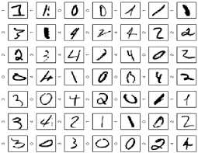
MNIST: 10 labels

Slide 3

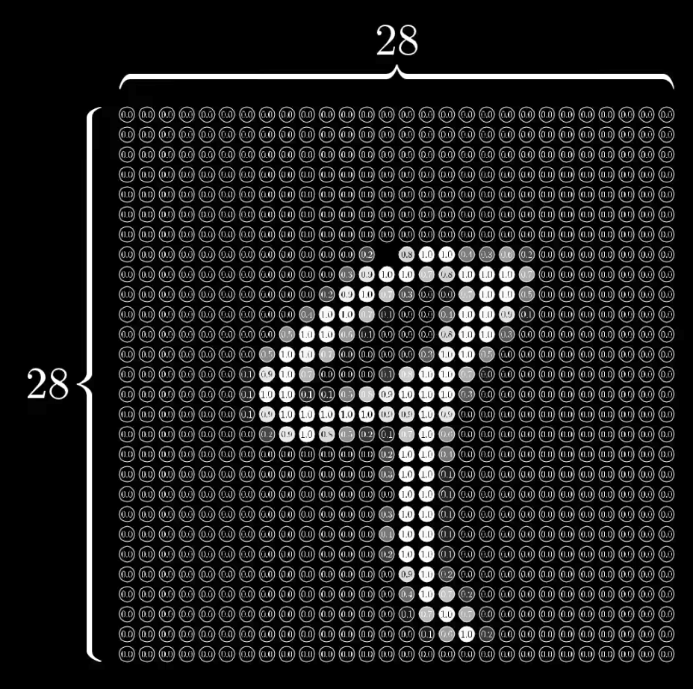
MNIST input
28x28 pixels = 784

Slide 4
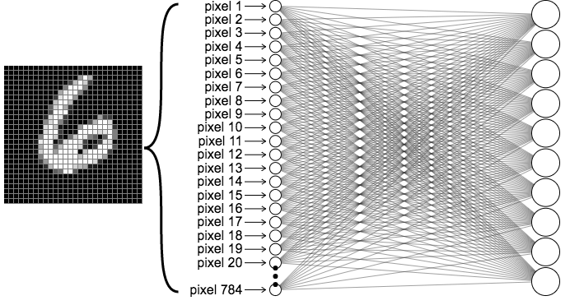

MNIST Network
output layer
10 (labels)
Input layer 784

Slide 5
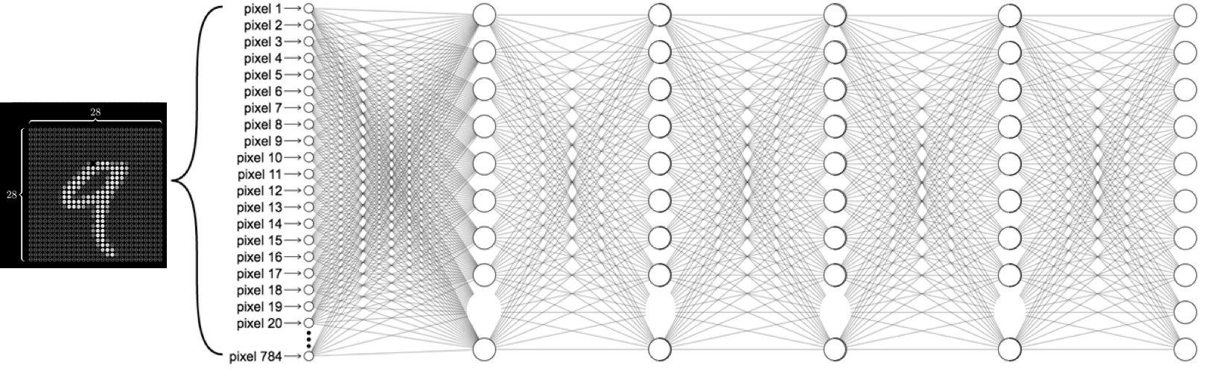
MNIST Network
Input layer 784
Hidden layers
output layer
10 (labels)

Slide 6
MNIST Network
Input layer 784
hidden 1: 520
hidden 2: 320
hidden 3: 240
hidden 4: 120
output layer
10 (labels)

Slide 7
MNIST Network

